Slide 1


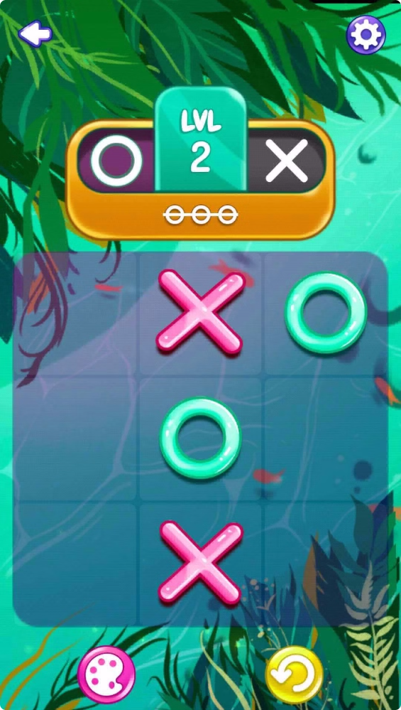
Introduction to Tic Tac Toe
Tic Tac Toe is a classic, simple game that can be enjoyed by people of all ages. This presentation will guide you through the process of building a Tic Tac Toe command line game using Python, from setting up the game board to implementing the computer player logic.

Slide 2

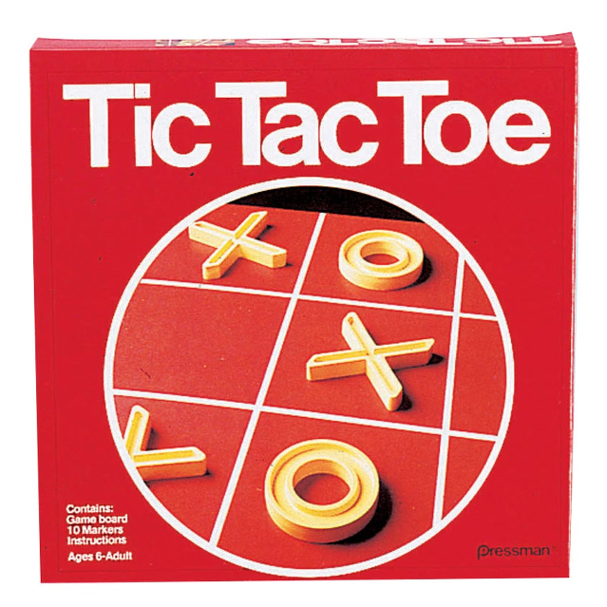
Overview of the Game
1
Two Players
Tic Tac Toe is a two-player game, where each player takes turns placing their symbol (typically X or O) on a 3x3 grid.
2
Goal
The goal is to get three of your symbols in a row, either horizontally, vertically, or diagonally, before your opponent does.
3
Simplicity
Despite its simplicity, Tic Tac Toe can provide hours of entertainment and strategic thinking.

Slide 3

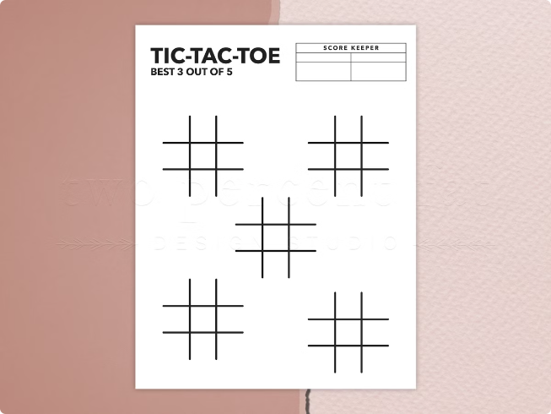
Setting Up the Game Board
Creating the Grid
The game board is a 3x3 grid, with each cell representing a valid move.
Initializing the Board
The board can be represented as a list or a 2D list in Python, with each cell initially set to a neutral value (e.g., a space character).
Displaying the Board
Implement a function to display the current state of the game board, making it easy for players to visualize their moves.

Slide 4
Implementing Player Input
Player Turns
Validating Moves
Error Handling
Implement a game loop that alternates between the two players, allowing each player to make a move.
Ensure that players only make valid moves by checking if the chosen cell is empty before updating the board.
Handle invalid user inputs gracefully, prompting the player to try again until a valid move is made.

Slide 5

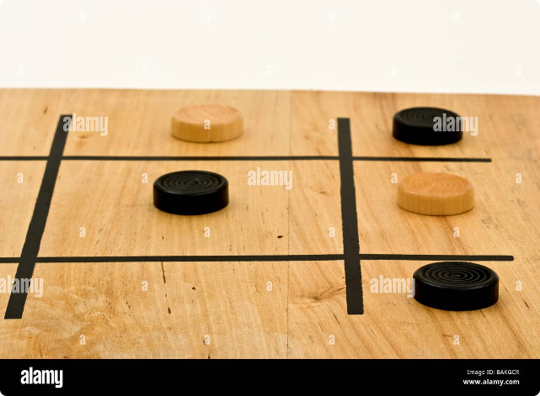
Checking for a Winner
1
Horizontal Check
Implement a function to check if a player has three of their symbols in a row horizontally.
2
Vertical Check
Implement a function to check if a player has three of their symbols in a row vertically.
3
Diagonal Check
Implement a function to check if a player has three of their symbols in a row diagonally.

Slide 6


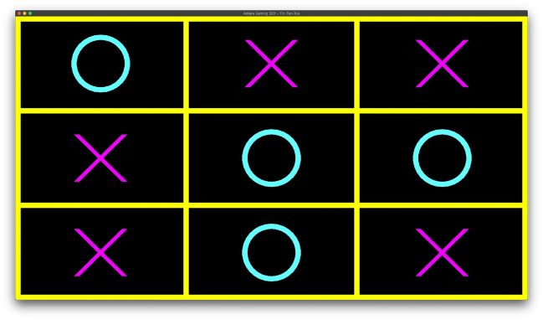


Handling Tie Games
Board Full
Check if the game board is full, indicating a tie game.
Declare Tie
If the board is full and no player has won, declare the game a tie.
Replay Option
Offer the players the option to play again after a tie game.

Slide 7





Incorporating Computer Player Logic
Random Move
As a simple starting point, have the computer player make random valid moves.
Blocking Moves
Upgrade the computer player to block the human player's potential winning moves.
Winning Moves
Finally, have the computer player try to make winning moves by identifying and exploiting opportunities to get three of its symbols in a row.

Slide 8
Improving the User Interface
Clear Displays
Colorful Symbols
Prompts and Feedback
Use command line clear functions to create a clean and uncluttered display for the game board.
Enhance the visual appeal by using different colors for the player and computer symbols.
Provide clear, informative prompts and feedback to guide the players through the game.

Slide 9

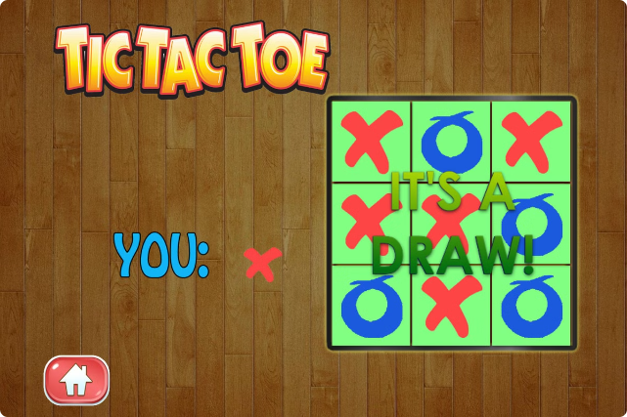
Handling Game Replay
1
Reset Board
When a game ends, reset the game board to its initial state.
2
Retain Scores
Keep track of the scores for each player, even if they play multiple games.
3
Replay Option
Offer the players the option to play another game after each completed match.

Slide 10

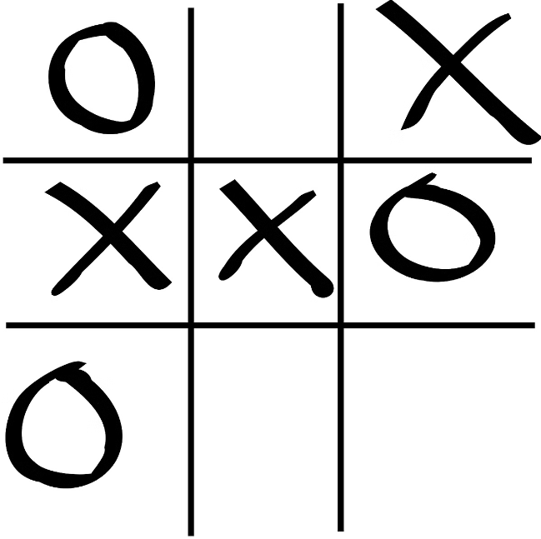
Conclusion and Next Steps
1
Recap
In this presentation, we covered the key aspects of building a Tic Tac Toe command line game using Python.
2
Next Steps
Consider adding more advanced features, such as a graphical user interface, online multiplayer, or even an unbeatable AI opponent.
3
Conclusion
Tic Tac Toe is a great starting point for learning programming concepts and building interactive games. Have fun coding!

